Slide 1

Gupta College of Science
Graduate Programs
M.S. Security and Data Analytics
M.S. Sport Management
M.S. Coastal Marine and Wetland Studies
Ph.D. Marine Science (Coastal Marine and Systems Science)

Slide 2
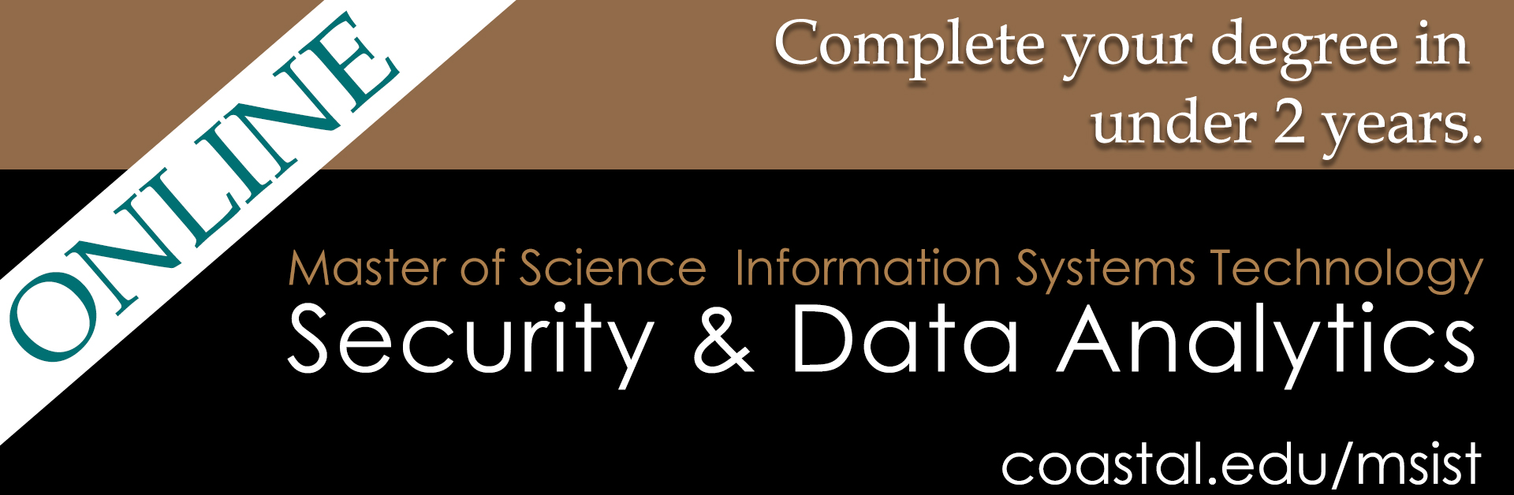
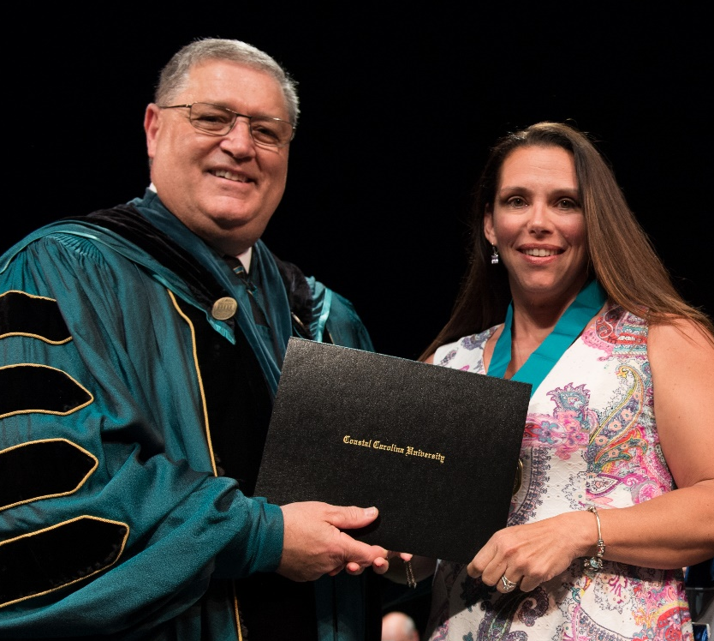
According to the U.S. Bureau of Labor Statistics, national employment growth for information security and data analytics-related occupations will increase by approximately 25 percent over the next decade (2018-2028).
Career Paths include information security architect, cybersecurity engineer, information security manager, IT security analyst/consultant, computer and information research scientists, BI specialist, data scientist, and more…

Slide 3

Master of Science in sport management
The Mission of the program is to prepare future leaders of the sport industry through critical examination of both academic and practical application of management principles to various segments of the sport industry.
The program will utilize a combination of traditional, experiential, and online instruction methods.
  Critical Thinking through real world application
  Networking Opportunities
  JOB or Career after graduation is the GOAL
90% of Sport Management Graduates had full time employment within 3 months!
Please open your chat to ask questions and visit https://www.coastal.edu/graduatestudies/ to request more information

Slide 4
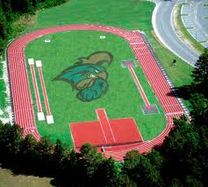
Program Overview
Your track to success
Electives - (6 credit hours)
Capstone (6 credit hours)
SPT 590 - Graduate Internship (6 credits)
or
SPT 599 - Research Thesis (6 credits)
Degree Requirements (30 graduate credit hours)
SPT 510 - Governance and Policy in Sport
SPT 515 - Legal Issues in the Sport Industry
SPT 530 - Leadership Theory and Applications in Sport Settings
SPT 560 - Understanding Sport Fan Behavior
SPT 565 - Revenue Generation and Fiscal Management in Sport
SPT 580 - Research Methods in Sport
Please open your chat to ask questions and visit https://www.coastal.edu/graduatestudies/ to request more information

Slide 5
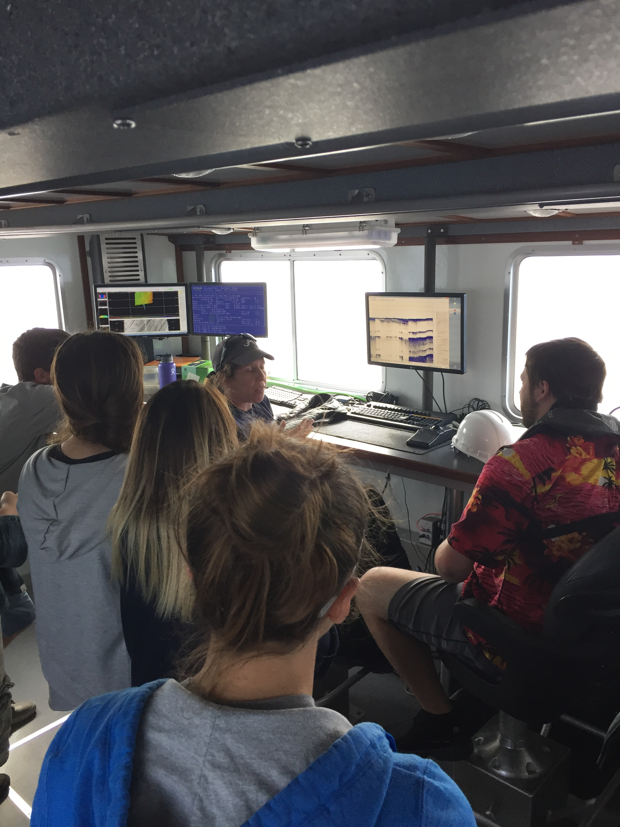
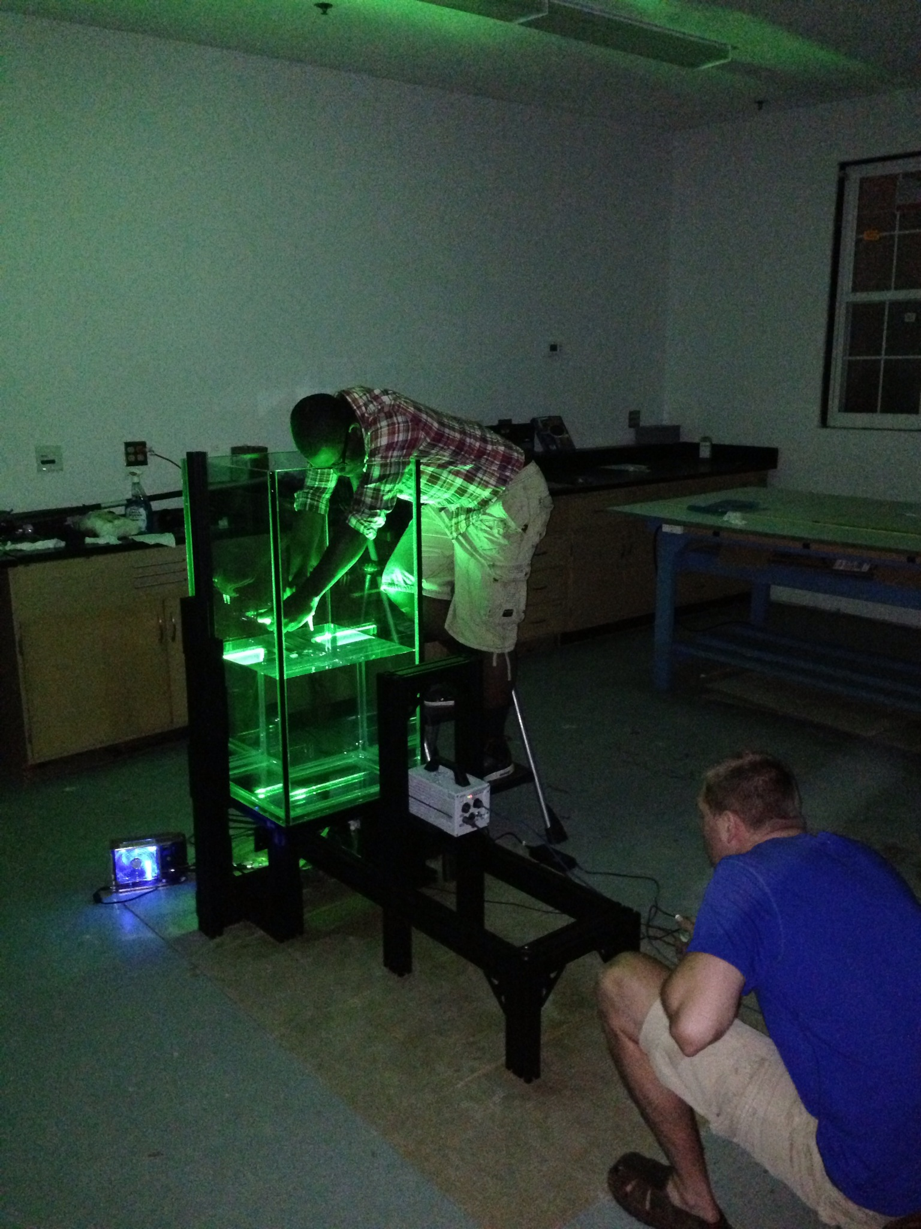
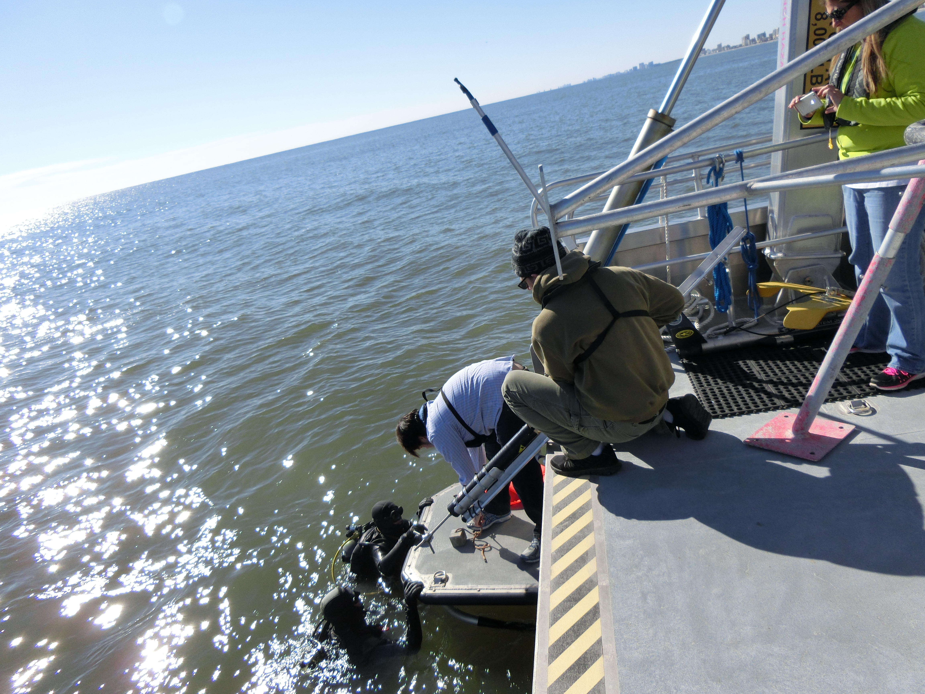
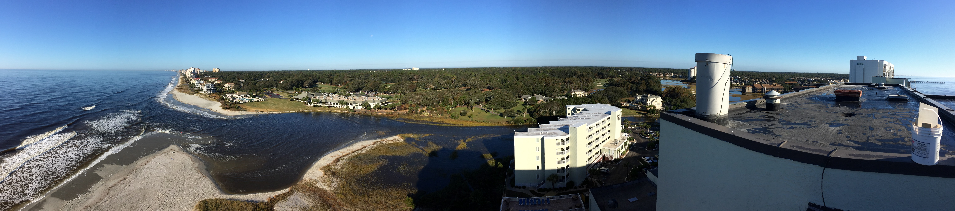
Graduate Studies
M.S. in Coastal Marine and Wetland Studies
Ph.D. in Marine Science
Hands-on field and lab experiences.
Thesis or non-thesis degree options.
Courses in computing, ecology, geology, environmental fluids, geochemistry, policy and more.
Opportunities to present at professional conferences.
For more information:
www.coastal.edu/sce/
Richard Viso, Ph.D. 843.349.4022 rviso@coastal.edu

